Slide 1
Arthur Lewis and Surplus Labor
Economic Development with Unlimited Supplies of Labor
Manchester School May 1954

Slide 2
A theory of underdevelopment but also how to take advantage of it
Parallel with Keynes’ special case of surplus resources (all) in General Theory
Return to classical theory in which distribution and capital accumulation play a large role in growth

Slide 3
Closed Economy Case
Case of economies where pop. Is so large relative to land, capital so that MPN = 0 or close to it
Not just in agric, but in self-employment in many parts of the economy
Even where workers are employed by employers, e.g. domestic service, where prestige. Also (1) family members and dependents, (2) rising population, and Marx reserve army (created by increasing productivity).

Slide 4
Diagram with given capital and other resources
P
W
O
M
R
Labor
Only OM will be employed in capitalist sector

Slide 5
Capitalist savings and reinvestment to increase employment and growth
N1
N2
N3
O

Slide 6
Contrary to Malthus and Ricardo
The expansion in modern sector may not raise rents in the rural sector. Hence wage rate can stay at subsistence wage for some time.
Theory of savings: Marx-Lewis. It is capitalists who save .
Through the accumulation process share of capitalist income in GDP rises so Inv rate accelerates. Here it is not lanlord rents but capitalist profits that rise

Slide 7
The labor employed is surplus in subsistence sector
Since MPN = 0, the removal of that labor has opportunity cost of 0
Assumes that can produce capital goods with just labor at first to get process going.
The original capital accumulation could also be financed by credit without much increase in prices since once output comes on stream the prices would fall. Government could also apply price controls if needed on modern goods or better raise taxes

Slide 8
This could go on as long as there exists surplus labor
But it could be impeded before that if real wages rise
  Removal of people might raise average cons in traditional sector
  TOT could go against modern sector as it expands
  Subsistence sector may be more productive
  Subsistence sector may imitate cons. Of modern sector

Slide 9
Lewis paid much attention to avoiding this problem
Increasing agric. Productivity. This could lower agric. Prices and benefit terms of trade of modern sector
Tax the agricultural sector as the USSR did
But eventually the labor surplus may end with continued capital formation and development

Slide 10
Open Economy Case
Could raise immigration on a sufficient scale to lower wages or at least offset the pressure for rising wages. This takes advantage of surplus labor elsewhere in world.(Of course, labor unions will oppose this)
Could Export capital, thereby limiting capital accumulation and removal of surplus labor at home. But this would depend on competition and other conditions. (1) It would especially reduce capital formation and wages domestically if it raises the cost of imports in modern sector or (2) could reduce costs in competing countries hence, reducing costs of food imports. Such investments however would depend on many things, its natural resources, human capital and productivity, and of efficiency of those industries suppling inputs to the industries in which the capitalists invest.

Slide 11
A More Detailed Look at the Case of Capital Exports

Slide 12
Cases in which the home country and the foreign one do not compete with each other
Case A. Each country produces one good but different ones. No trade Wage rates not determined in relation to one another.
Case B: Each country produces two or more goods one of which is the same and is the subsistence good and the other wheat in country A, peanuts in B. Relative prices determined by supply and demand. If there is capitalist sector in country A wheat, it could take advantage of surplus labor,investing in wheat until wage rates and subsistence prices start to rise. After this it might invest in B. But before this, the rise in wheat output would raise the price of peanuts, harming the country A’s terms of trade and making both capitalists and workers in A worse off in terms of peanuts though the same in wheat. Those in B would be better off in terms of wheat but the same in peanuts When Capitalist sends capital to B, the opposite occurs, and terms of trade move against B workers and in favor of country A’s workers

Slide 13
Lesson of Case A: Capital exports from A benefit the workers on balance if it applies to things they import
Case B. The terms of trade are now determinate
If both countries produce food but do not trade food, A produces steel and country B rubber. If B can release unlimited supply of labor from subststence food, wages will equal average product in food . In country A the wage cannot fall below productivity in food
Assume in A that 1 day of labor produces 3 units of either food or steel, whereas in B 1 day of labor produces 1 unit of food or rubber . Earnings in A will therefore be 3 times those in B. And the rate of exchange will be 1 unit of food= 1 unit of steel = 1 unit of rubber.

Slide 14
If productivity in rubber in country B increases so that 1 day of labor produces 3 units of rubber, this will benefit workers in country A but not those in country B since their wage will still be 1 unit of food.
But if it was the subsistence sector food which became more productive, wages would rise in B and be as high as in A and the price of rubber would now be high (3 steel)
Workers in A benefit when productivity increases in what they buy (rubber) but are hurt when it is in B’s subsistence sector. Workers inB benefit only if productivity increases in their subsistence sector. Otherwise they lose through terms of trade.
Foreign investment has typically been productivity increasing in the non-subsistence crops, benefitting the foreign country

Slide 15
Case C: Where the two countries produce the same things and can trade with each other
Country A: labor is becoming scarce with capitalist development, B has unlimited labor supply in subsistence food. APs: Labor yields 3 food or 3 cotton in A and 2 food or 1 cotton manu in B
The MPs in A 3 food, 3 cotton manu.
The MPs in B 0 in food, 1 in cotton manu.
In this case B should specialize in cotton manu and import food Yet in practice wages will be 2 food in B but between 3 and 6 food in A, making it cheaper for B to export food and import cotton, thereby potentially destroying industry in Country B with surplus labor. Money costs are misleading in countries with Surplus Labor

Slide 16
This depiction would be changed if there are other scarce resources
Even if labor is unemployed, it may pay more to use capital to increase the production of food than to use it in modern manufacturing . But there may well be cases where this is not true, especially in handicraft industry which uses very little capital

Slide 17
Continuing with case of DC and Surplus Labor countries
Labor in A produces 5 food or 5 cotton manu. Labor in B produces 1 food or 3 cotton manu.
B will specialize in cotton, wages, prices determinate, Wage in B =1 food, Price of cotton: 1 cotton =1/3 food. The wage in A will be 5 food and A will get the benefit of the exchange.
If productivity in B’s cotton indus. rises, B’s wage is unchanged and benefit accrues to Country A, cheaper imports of cotton.
But if the productivity in B’s food industry rises , B’s wage will rise, A’s wage will remain the same in food but cotton will be more expensive, bringing a terms of trade benefit to B.

Slide 18
Case D: Countries A, B produce competing goods to sell in third markets
If capital is exported from Country A to B. If it raises subsistence productivity in B , the workers in A will benefit, since wages of their rival will be increased. But if it goes to increase productivity in B’s export sector it will hurt workers in Country A by both reduced capital frmation and the fall in prices of their competitors

Slide 19
Possible Controversial Policy
Modern sector should be protected in LDCs with surplus labor

Slide 20
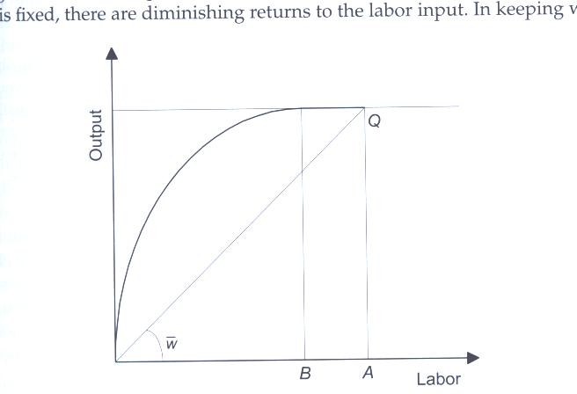
Fei –Ranis Extension

Slide 21
They call attention to details of traditional sector in the process
Three phases identified:
  Pure surplus
  Partial surplus
  Disappearance of surplus labor
Another look at the Modern Sector
  During the same phases

Slide 22
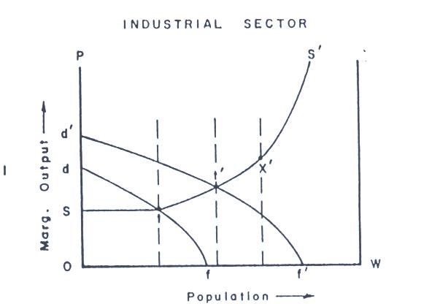

Slide 23
Now Agriculture
Think of the agricultural production function inverted so as to work in the other direction. Moving to the right is removing labor from the sector

Slide 24
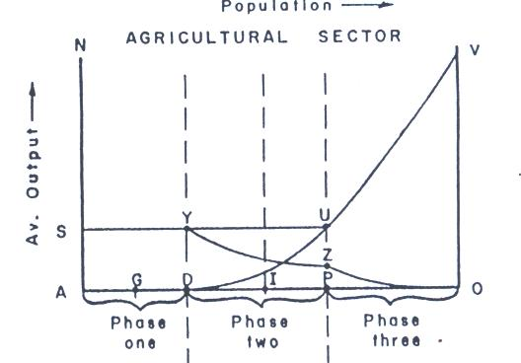

Slide 25
New Concept: Average Agricultural Surplus
Average agricultural surplus (AAS) remains constant in Phase 1. Each departing worker takes with him the same surplus
But once that stage is exhausted, the AAS declines, possibly causing shortages of food to develop and prices to rise

Slide 26
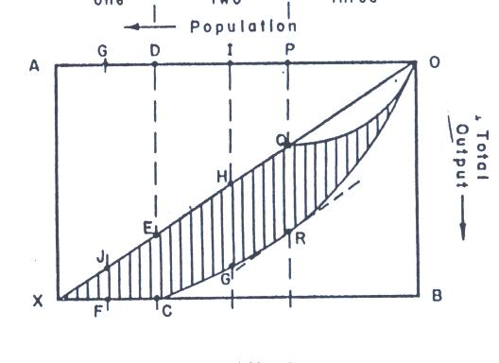

Slide 27
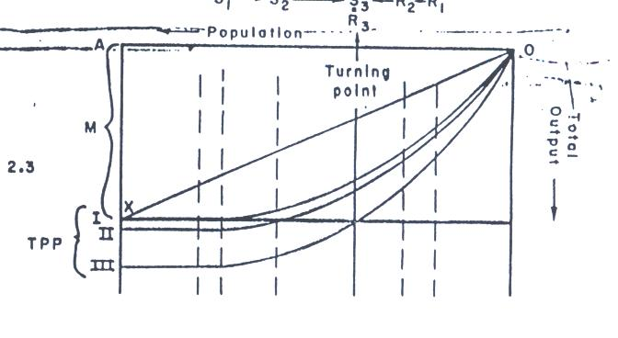
Technological Change in Agriculture Fig 2.3

Slide 28
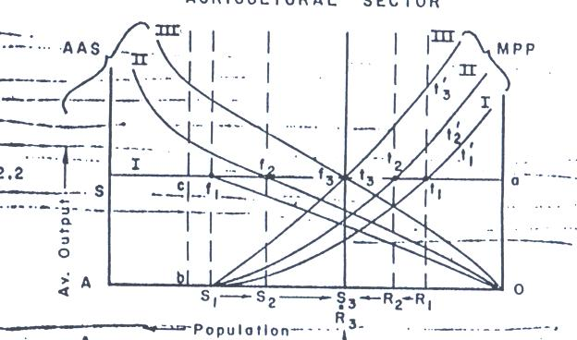

Slide 29
Note from this Figure 2.2
That AAS is shifting to the right and MPP curve to the left indicating the gap between MPL =0 and turning point where MPN=Wage rate diminish and evenually disappear
This eliminates Phase II

Slide 30
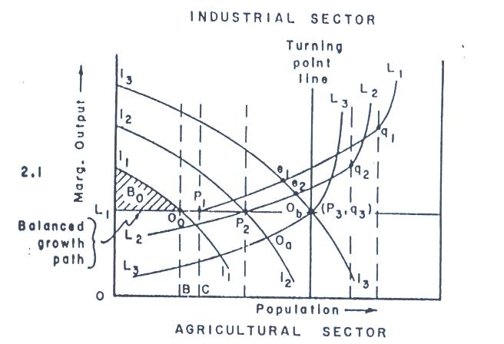

Slide 31
Extensions
Sen: Surplus People with Reorganization even if no surplus labor to start with: cooperatives
Challenge for Economics: What explains behavior in agric. Where MPN not equal to wage?
Policy Implications to take advantage of labor surplus

Slide 32
Ragnar Nurkse
Where will the demand for modern sector (manufactures) come from?
His solution Balanced Growth
Ranis and Fei incorporate this in their analysis. Industry sector must provide the demand for the surplus workers and agric sector the demand for modern sector products and on the Balanced Growth Path LP3.
If not on this path the TOT will go against one of the sectors as at e2 in Fig 2.1 with too much I in Manufacturing Sector, shortage of food

Slide 33
Larger increase in population require greater increases in manufacturing
More industry is required to absorb the surplus labor
This means that industrial investment effort will have to be increased. Lower rates will lengthen the time required to achieve this . Successful take off from the turning point may not be feasible in some cases. . Big push needed depends also on initial position of surplus labor and the non-redundant share

Slide 34
Empirical Evidence
The natural experiment of Theodore Schultz 1964
  India’s influenza epidemic or 1918-19
  Schultz compared acreage before (1916-17) and after (1919-20). Rural population declined by 8.3%, acreage sown by 3.8%. Provinces with greatest death rates had the largest decline in acreage sown to crops. He interpreted this to be evidence against MPN=0. But since entire households might be wiped out, the acreage decline could occur without necessarily denying surplus labor within each household.
  Schultz also cited road building project in Peru, where when labor was recruited for project agric. Production declined.

Slide 35
Indirect Evidence
Measure disguised unemployment as (labor available - labor required to produce the current level of agricultural output)
Kao, Anschel and Eicher provide survey: issues: seasonality, what ages of people to include. Mostly Asia in 1930s, 40s
Rosenstein –Rodan for South-eastern Europe during war
When seasonality taken into account Pepelasis and Yotopoulos et al show that in peak there is typically shortage
Anthropological studies of Sol Tax in Guatemala and David Hopper in India

Slide 36
Fei and Ranis and Jorgenson
use historical data to try to identify the periods of their model in Japan and Taiwan based on real labor income per capita in agric
But Jorgenson looks at both traditional and modern sector and shows rapidly rising wage during these periods
Jorgenson also shows that growth was not accelerating as predicted by the classical model and that K/Y did not decline
But Jorgenson assumed C-D function. None of this disputes that some selected removal of labor would not lower output.

Slide 37
Other Evidence and issues
Seasonality, peak and trough periods
Agricultural production functions and MPN and wage comparisons
Utilization of labor within the HH
Lots of issues about production functions and what can be estimated, what functional forms should be used

Slide 38
Theories of dualism
Technological
Transaction costs and imperfect markets
Social dualism
Barriers to mobility

Slide 39
Eswaran and Kotwal 1993
Provide a two sector growth model with Engel curves built into preferences so that as modern sector grows it doesn’t pull up traditional sector.
Ways around this: develop by exporting manufactured goods
Initial level of income and distribution of wealth influence the growth rate of wages.

Slide 40
Model
Grain = f(L, N)
Textiles = f(N)
Investigate what happens when productivity rises in textiles. Does wage rate rise and labor shift. If labor demands primarily grain this might not happen. Hence poverty might not be eliminated by industrial development.

